Slide 1
Classification Of Singapore Traffic Road Sign
AI Applications
© Kenneth Foo. All rights reserved

Slide 2


© Kenneth Foo. All rights reserved
AI Applications Student | CV Graded Assignment
Honor Pledge for Graded Assignments
“I affirm that I have not given or received any unauthorized help on this assignment, and that this work is my own.”
Signature:

Slide 3
Summary
Data Pre-Processing
Model Creation
Prediction Results
Difficulties Encountered & Learning Points

Slide 4
Data Pre-Processing
Train Test Split
Stop Sign Folder
Uturn Sign Folder
30
30
Train Test Split| 50% : 50%
Train Folder
Test Folder
Stop
Uturn
Stop
Uturn
15
15
15
15

Slide 5
Data Pre-Processing
Data Augmentation
Add 75 more augmented images
Both classes in Train Folder
Train Folder
Test Folder
+ 75
Stop
Uturn
+ 75
Stop
Uturn
15
15
15
15
GaussianBlur | ImageDataGenerator

Slide 6
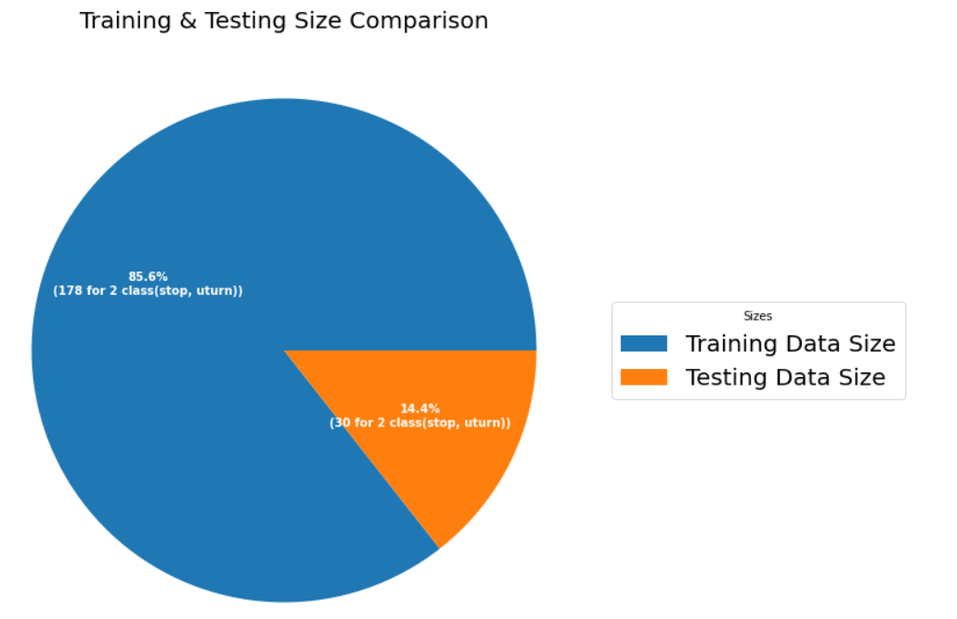
Data Pre-Processing
Pie Chart

Slide 7
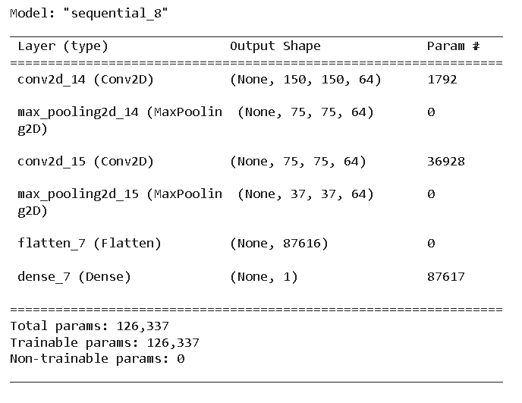
Model Creation
Convolutional Neural Network
2 Conv Layers
2 MaxPooling Layers
1 Flatten Layer
Ouput Dense Layer

Slide 8
Model Creation
Model Architecture | Kenneth | CV Graded Assignment
Layer Dimensions
Stride
= MaxPooling Layer
(h x w x d )
( Filter step size )
h = Height | w = Width | d = (depth) = number of filters
Flatten Layer
(37 x 37 x64)
d
(150 x 150 x64)
Conv
Layer 1
d
(2 x 2) strides=2
(75 x 75 x 64)
sigmoid
Conv
Layer 3
h
87616
h
(2 x 2) strides=2
…………
(1)
w
w
© Kenneth Foo. All rights reserved

Slide 9
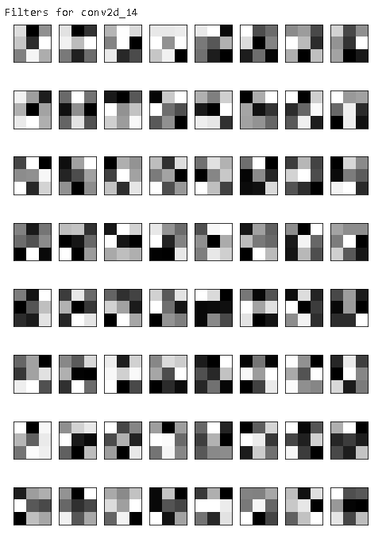
Model Creation
Understand the filters from the first layer
3 by 3 by 64 filter

Slide 10
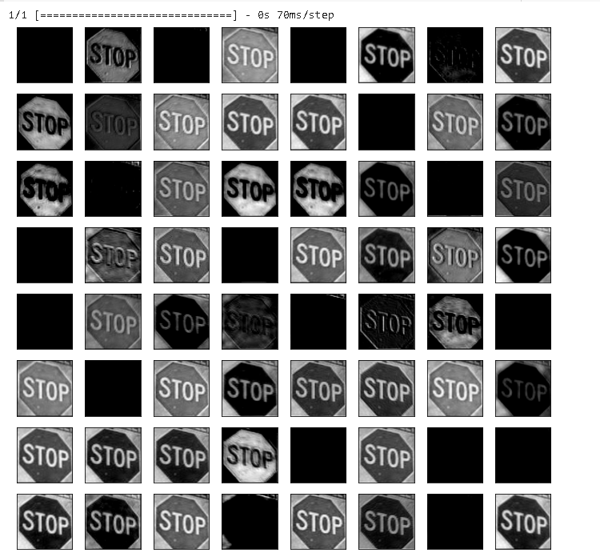
Model Creation
Define a new truncated model to only include the conv layers of interest
Generate feature output by predicting on input image
Representation Learning
Low & High level features on the right side. ->

Slide 11
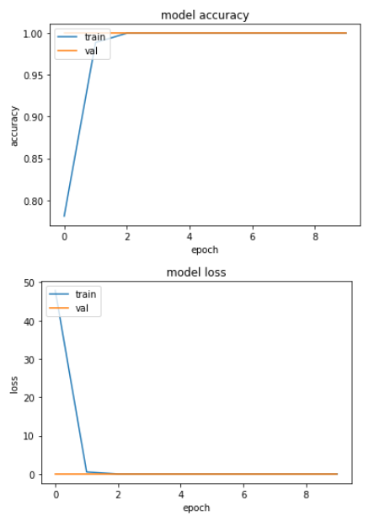
Model Creation
Model Performance during training and validation

Slide 12
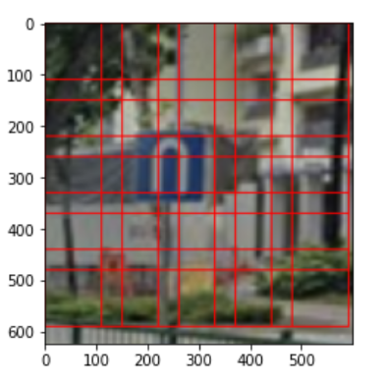
Prediction Results
Object Detection for Image
Constructing a sliding window
Constructing a image pyramid
Adjust window for optimal parameters
Select image for detection

Slide 13
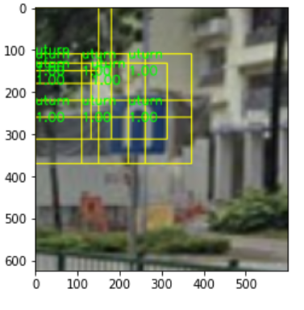
Prediction Results
Object Detection for Image
Looping over pyramid
Classifying ROIs
Do Prediction
Generate Object Detection Results

Slide 14
Difficulties Encountered & Learning Points
“The first difficulty I encountered was the overfitting of my model. I believe the reason for this was because the training and testing sets were too simple for the model to learn, so it probably became overconfident. The way to counter this issue, is to provide an equal ratio of images to both train & test sets. Also, when doing data augmentation, try to not only generate images, but to look at them at different perspectives or maybe you can even flip the image. Reason for doing that is to give a little confusion and information to the model so it learns better and performs better during predictions. The second difficulty encountered was constructing the parameters for the sliding window during image object detection, as different parameters are needed for the difference in images.”

Slide 15
End of Presentation

